Slide 1

Leave management system
By:- Vansh Malhotra(047) ,
Sachin sharma(046)

Slide 2
Introduction
Leave management system project is a web based system which can be accessed all over the organization or company. This system is automated system for managing leaves related information of employees and approval of leaves, payment cancellations etc are element of this system . In this system, every employee is provided with the unique user id and password for log in to the system and send request for leave. The project managers will look after the proposals and they may accept, reject or keep it in pending. Before approving the leave different department people look after the request through this system and make their decisions. This system will upgrade the process of leave management inside the company or an organization by saving time and money. It help the employees to view leave balances, request leaves , view past leave history and managers can review and approve the leave applications. This system is very useful for the companies or organizations where there are a large number of employees. It is an online system which can be used throughout a corporate company. This system has many features such as providing notifications of approved/ disapproved leaves, pending leaves, leave cancellation, automated leave approval and report generation based on the requested data by the user.

Slide 3
ADMIN

Slide 4
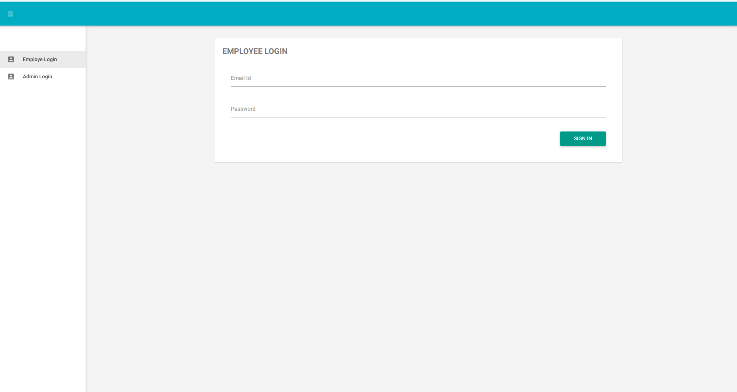
Output
#Login_page

Slide 5
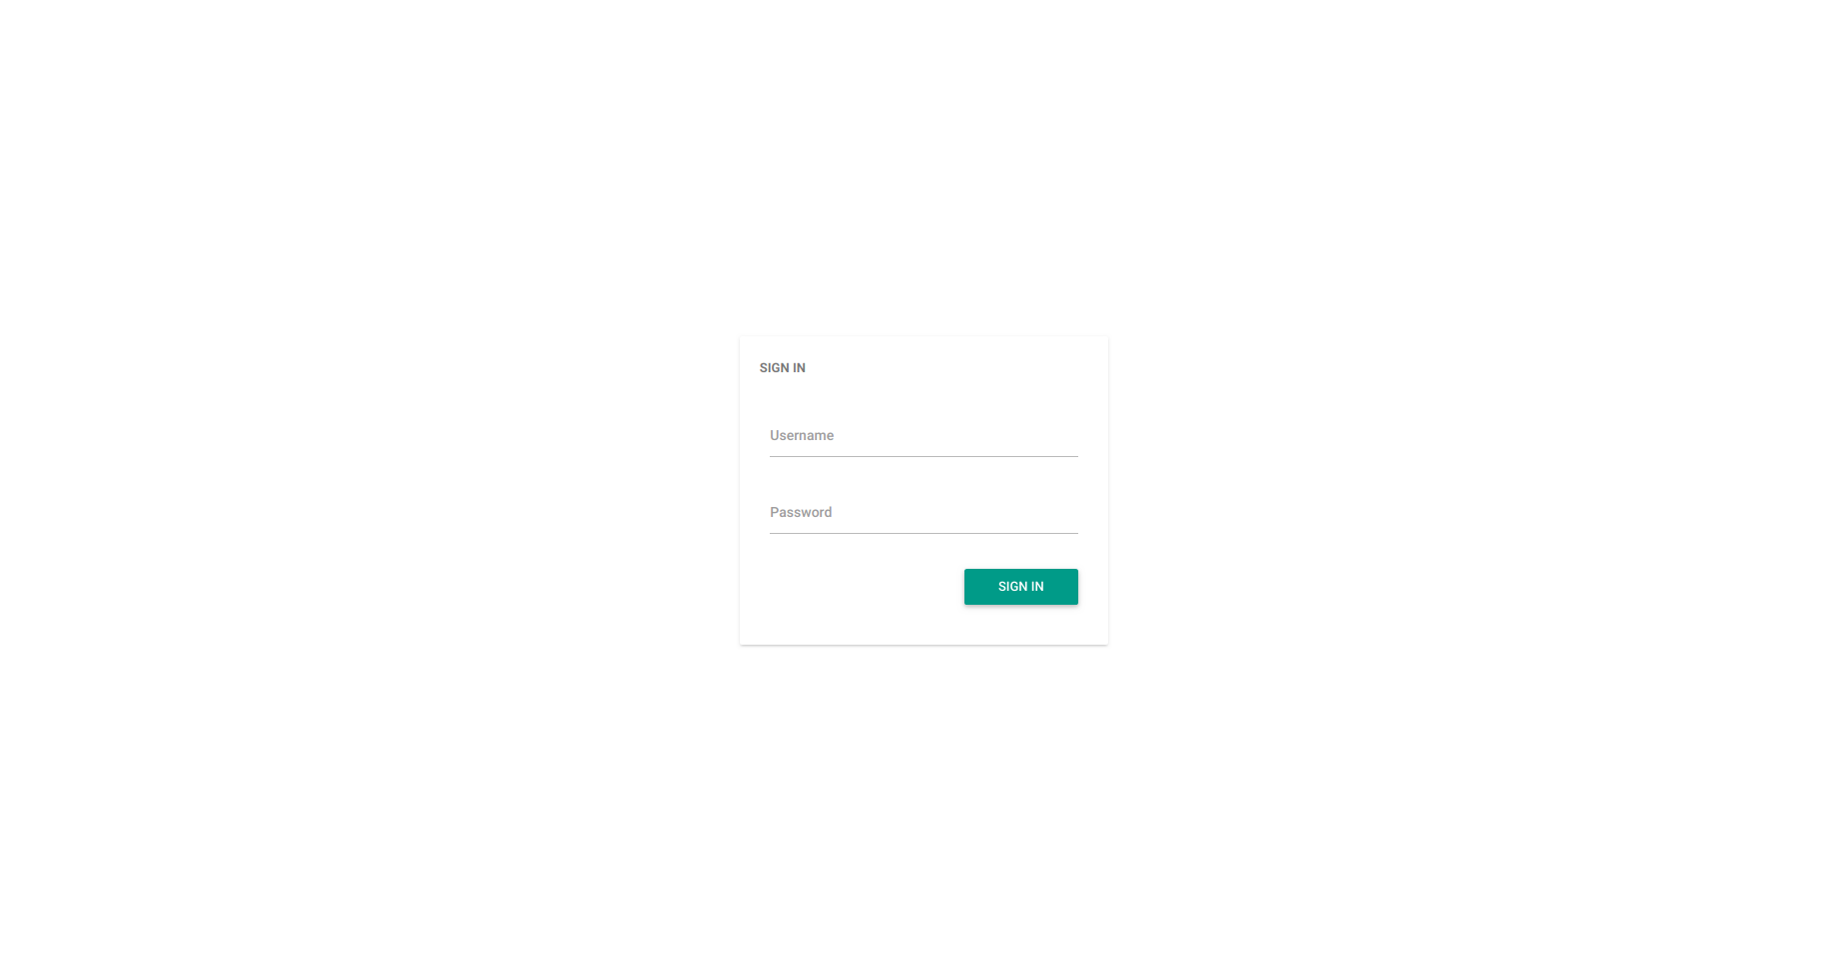
Output
#Login_page

Slide 6
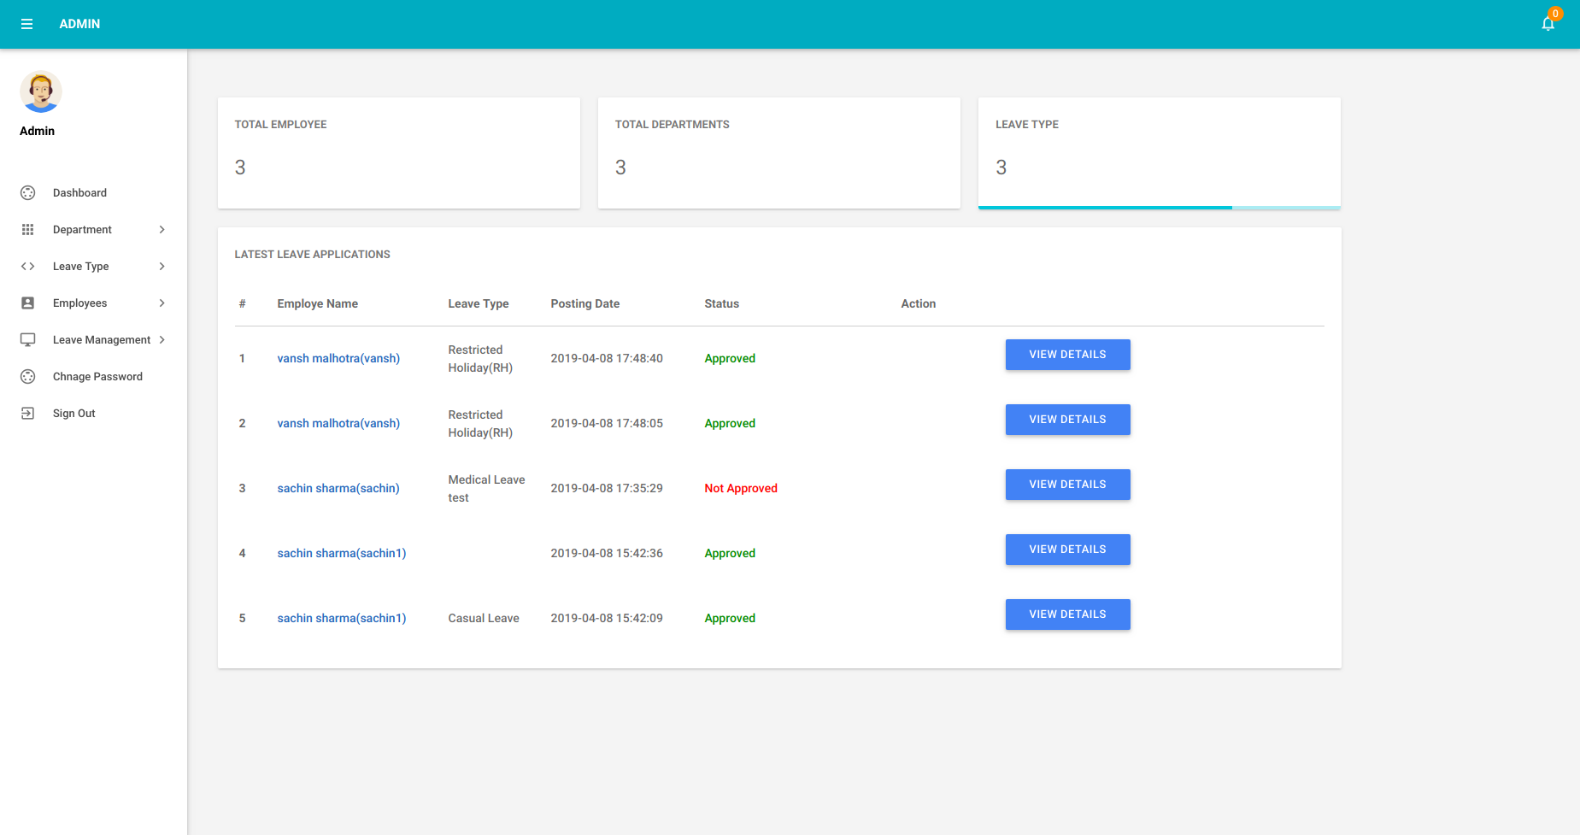
Output
#Login_page

Slide 7
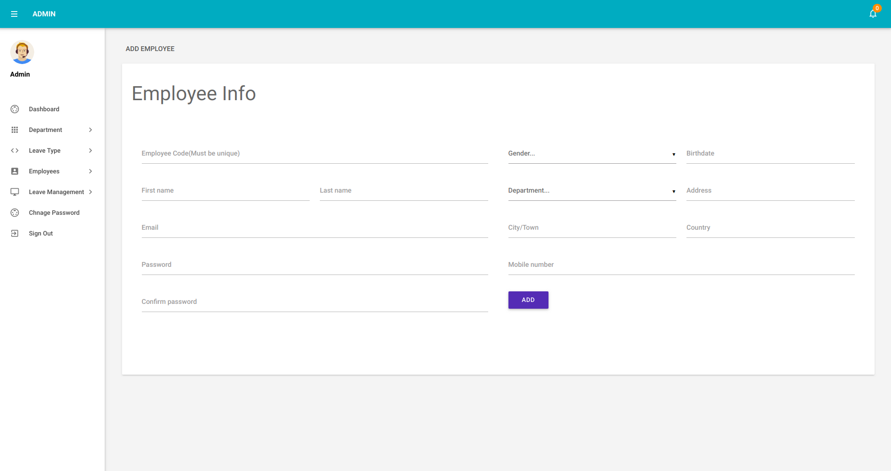
#Register_page

Slide 8
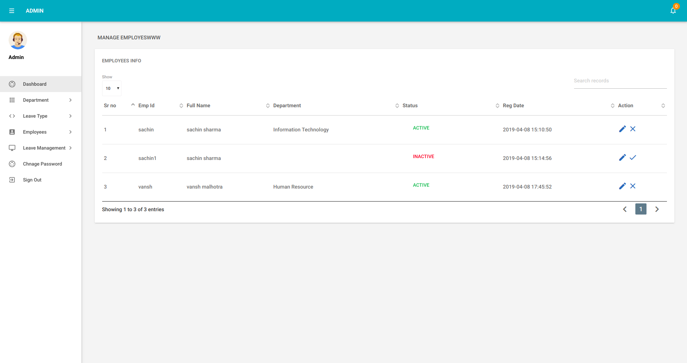
Output
#Login_page

Slide 9
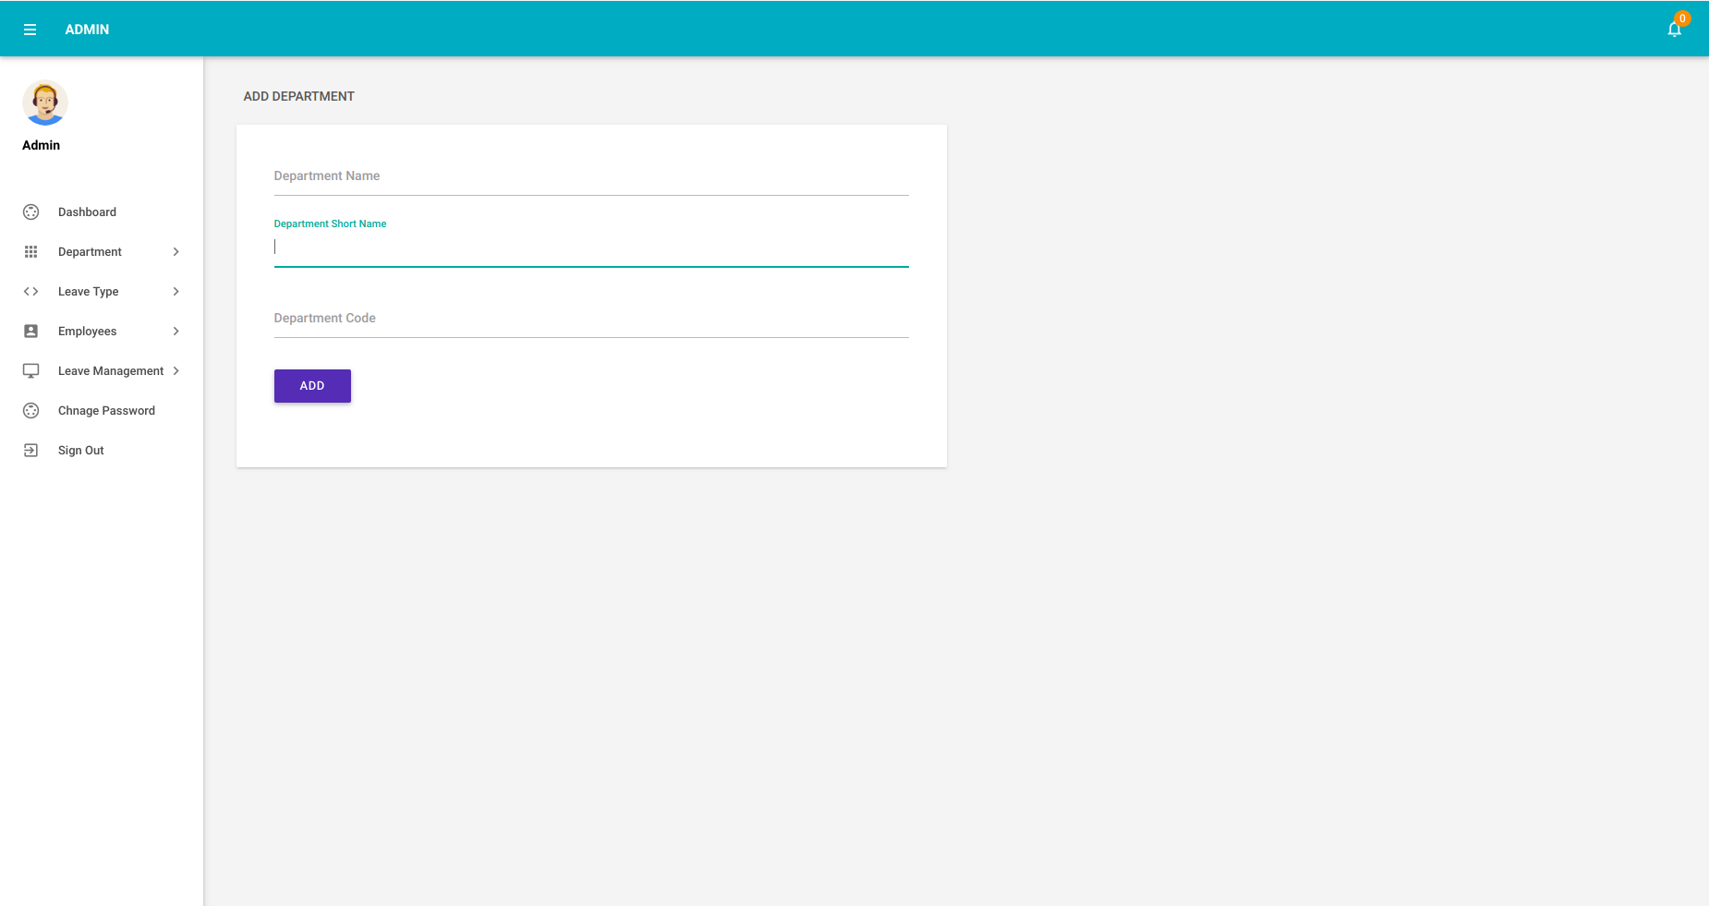
Output
#Login_page

Slide 10
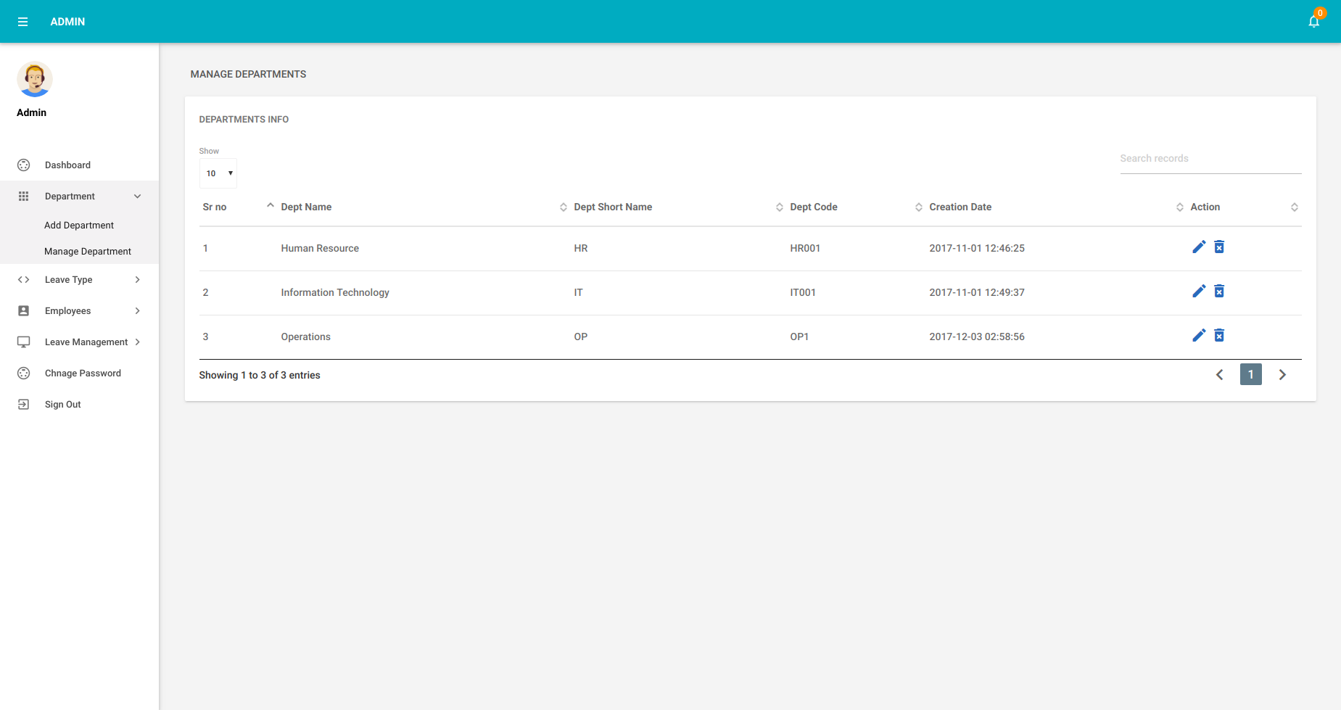
Output
#Login_page

Slide 11
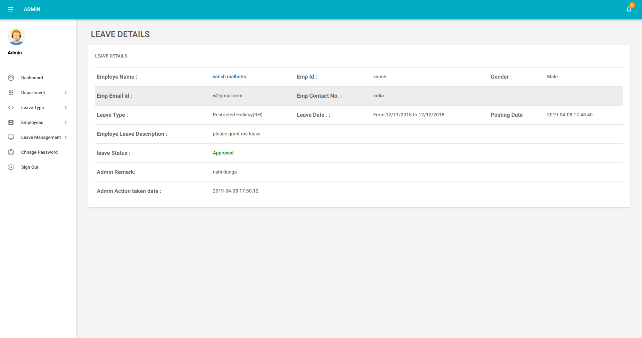
Output
#Login_page

Slide 12
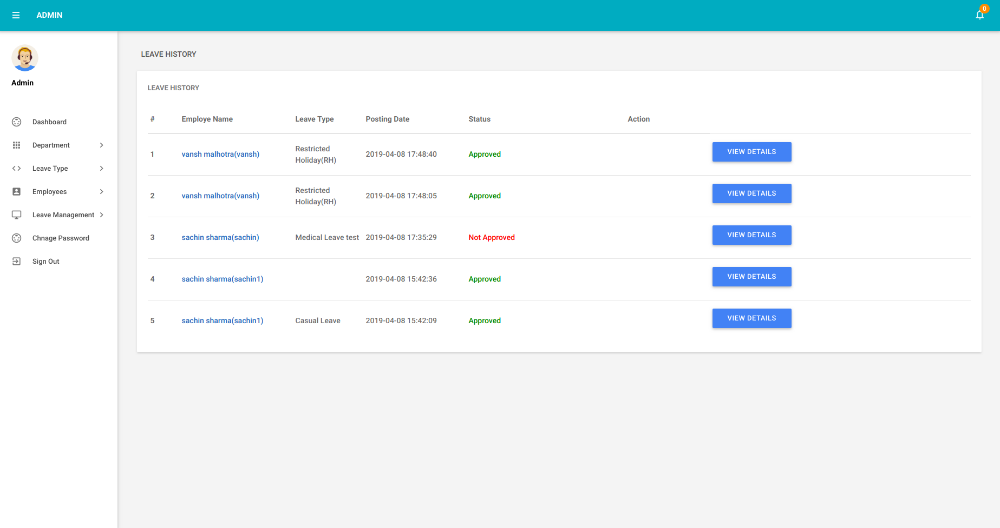
Output
#Login_page

Slide 13
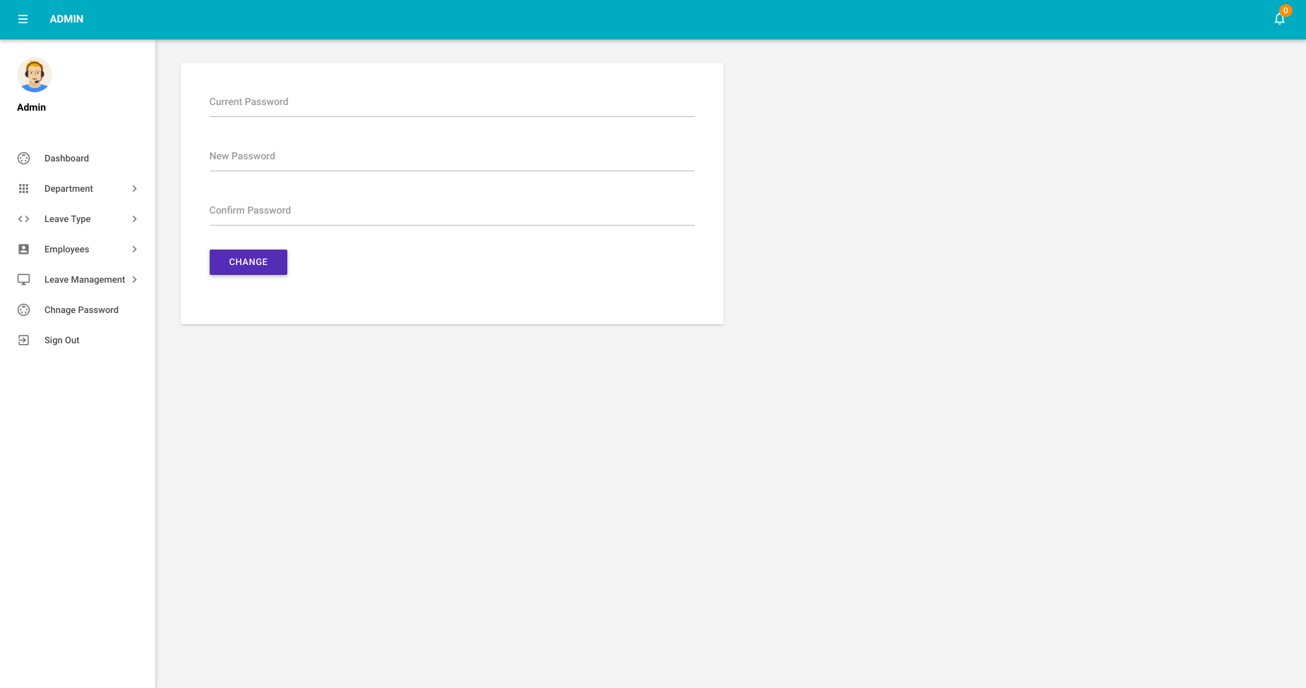

Slide 14
EMPLOYEE

Slide 15
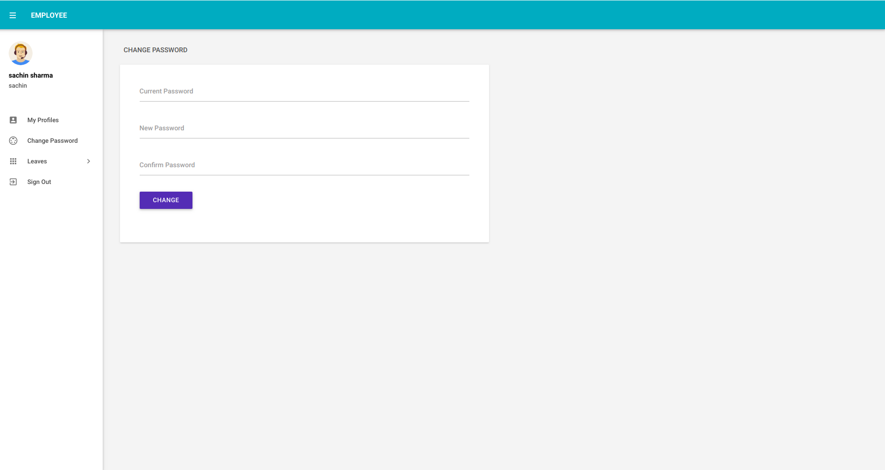
EMPLOYEE

Slide 16
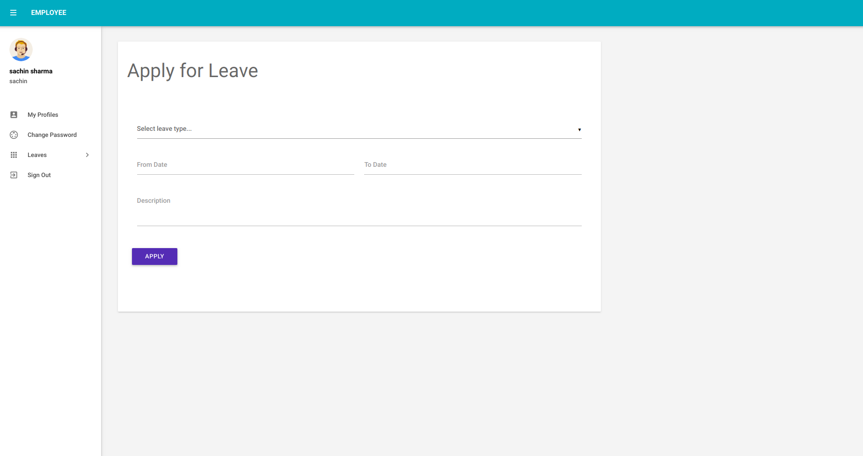

Slide 17
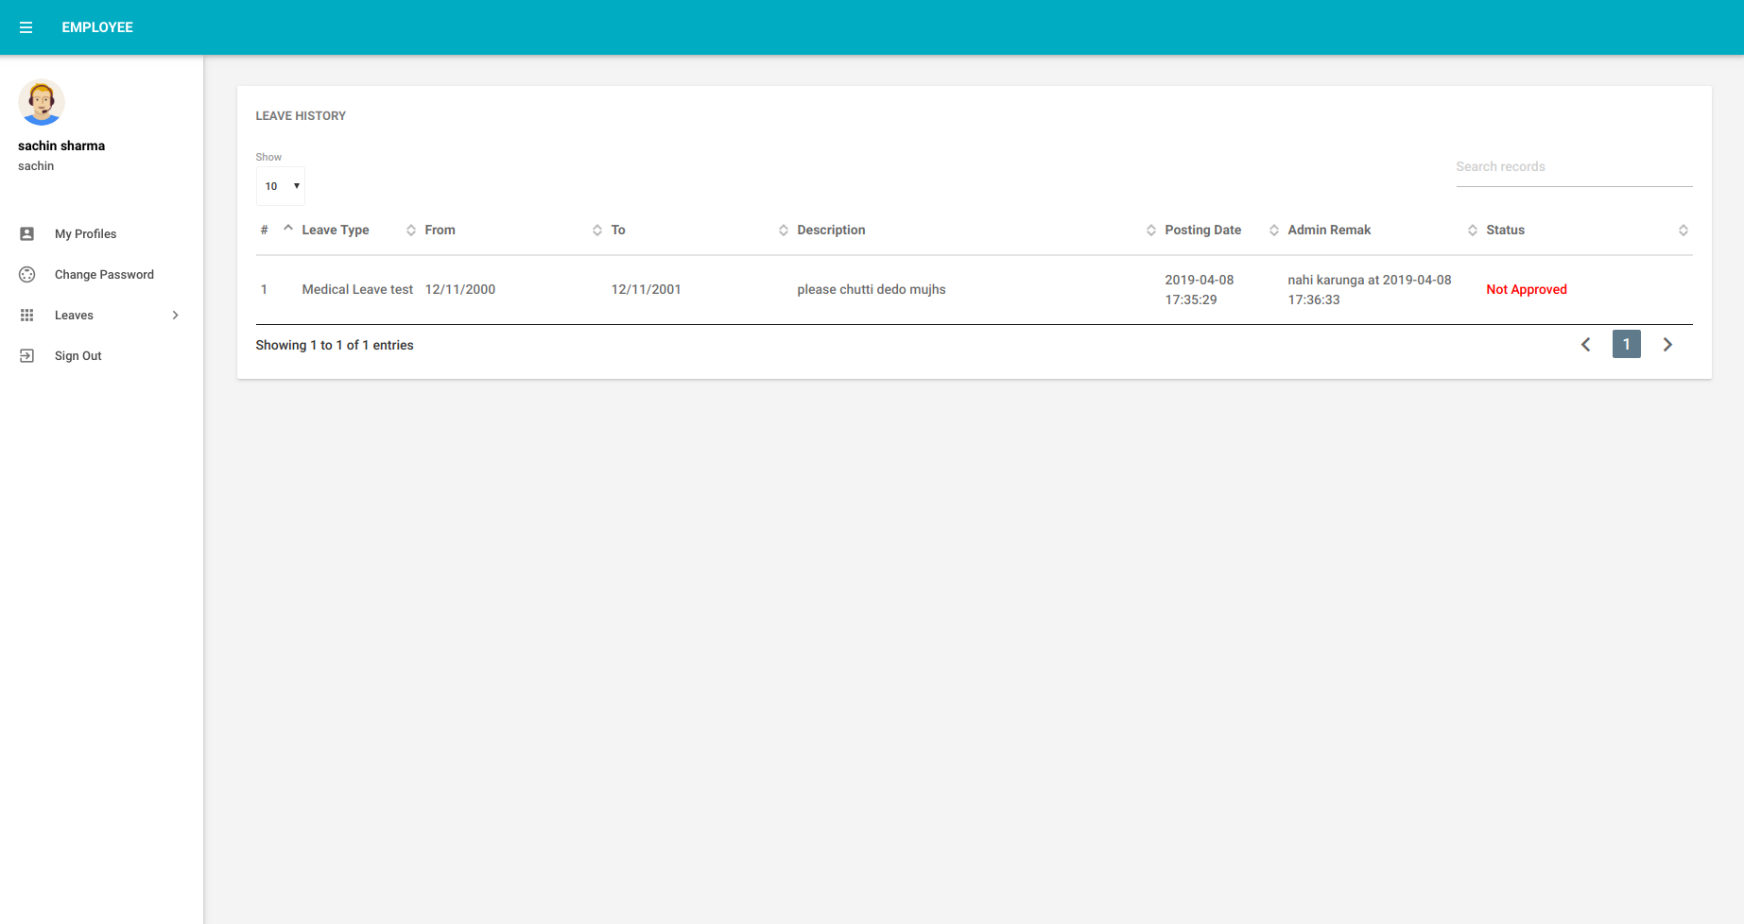

Slide 18
Thank You

